Slide 1
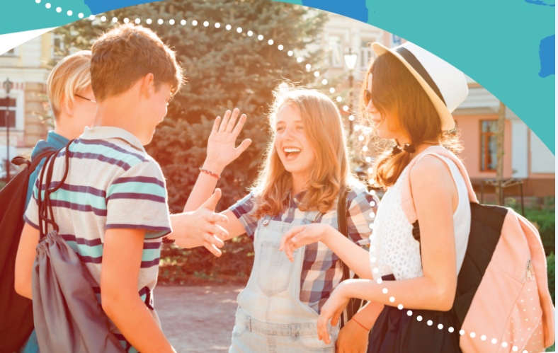


UNIT 5: Where I live
Two famous parks

Slide 2
Do you like going to parks?
Do you think they’re important? Why?
What can you do there?

Slide 3
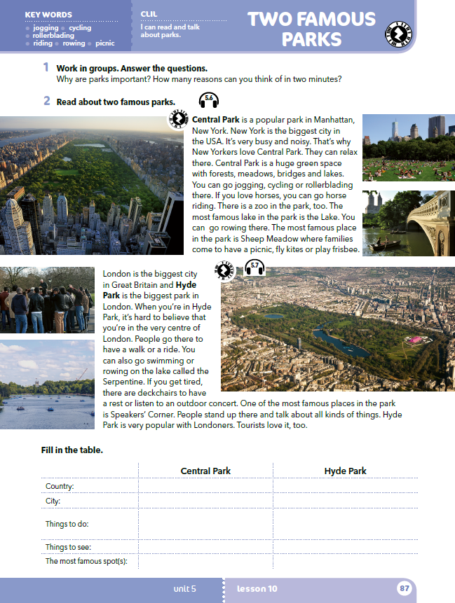
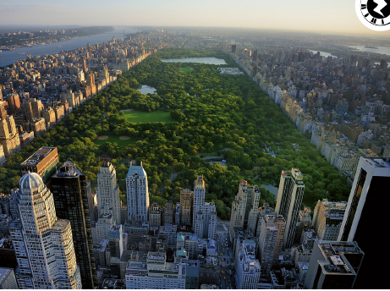
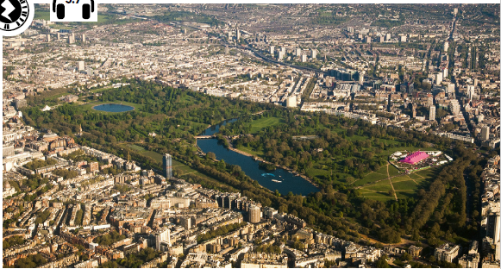
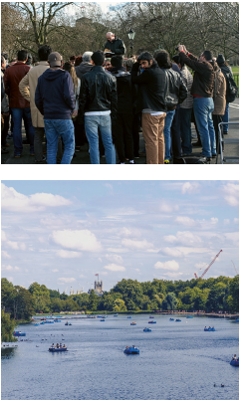
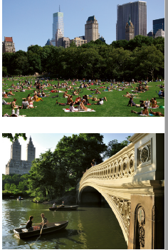
Open your book at page 87.
What can you see in the pictures?
Where are these parks?
Do you like pictures? Why?

Slide 4
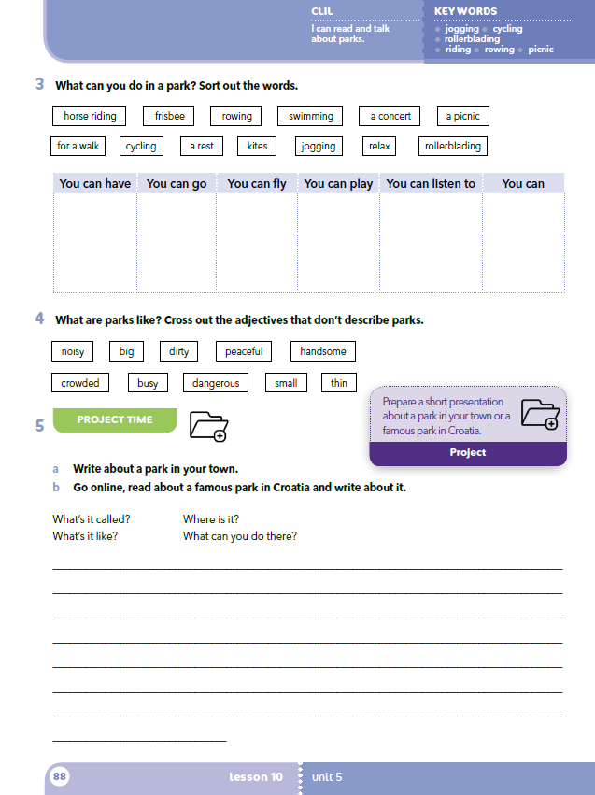
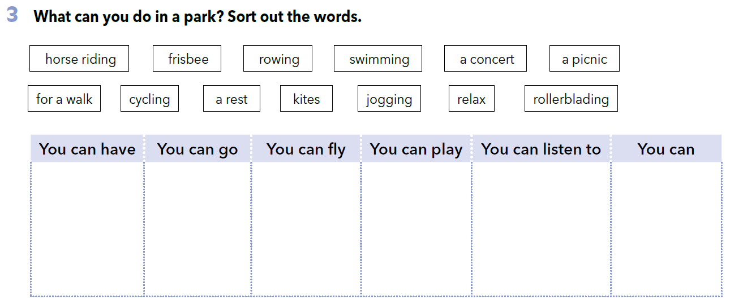
horse riding
rowing
swimming
for a walk
cycling
jogging
rollerblading
a picnic
a rest
kites
frisbee
a concert
relax

Slide 5
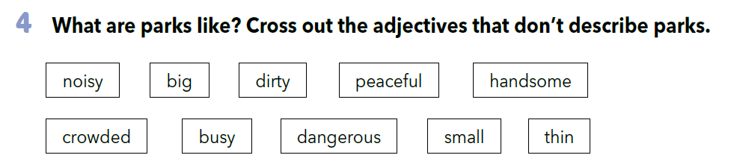

Slide 6
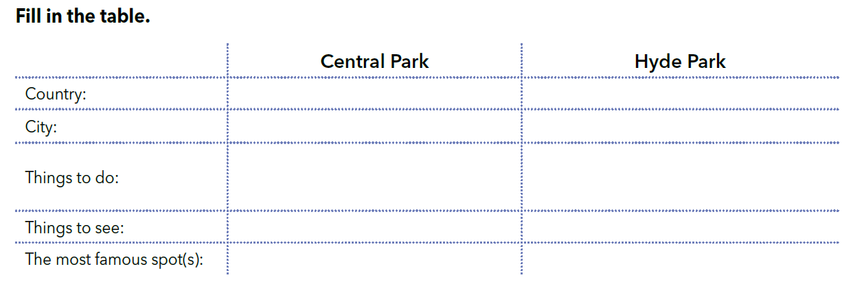
Work in two groups. One group reads the text about Central Park and the other reads about Hyde Park (book, page 87).
Fill in the table with information about Central Park or Hyde Park.

Slide 7
Your teacher will assign you a pair. Share the information about ”your” park with your partner and after that listen to the information about the other park which your partner will give you and write them in the chart.

Slide 8
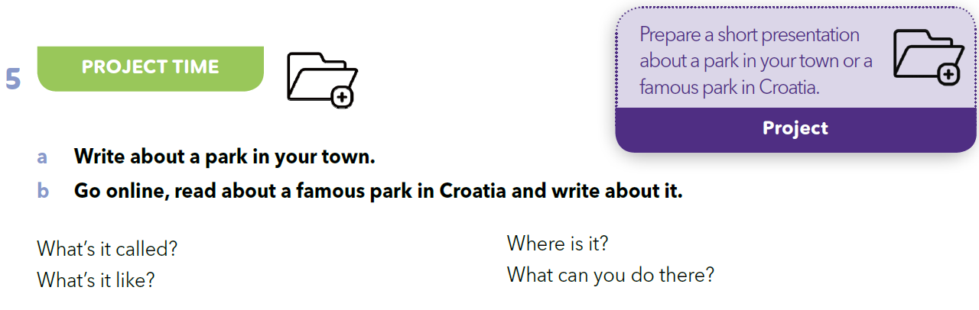
PROJECT TIME
Kako se zove?
Gdje se nalazi?
Kakav je park?
Što ondje možeš raditi?
Choose a park in your town or any famous park in Croatia.
Go online, find the information and prepare a short presentation about it.

Slide 9
PROJECT TIME
Present your park to a group of 6-8 pupils.
In your notebook write which of the parks you would like to visit most of all and why.

Slide 10
SELF-CHECK
How much do you remember about Central Park and Hyde Park?
https://wordwall.net/play/260/230/148
https://wordwall.net/play/260/233/745

Slide 11

LEARN MORE.
https://www.e-sfera.hr/dodatni-digitalni-sadrzaji/2c4a0b23-2d53-4665-a73e-c14f27404bf0/
Welcome to Maksimir!

